Slide 1
Welcome to BB2550! Dr. Amity Manning
3/12/2018
Lecture 1
This course will use poll everywhere.
log on at https://pollev.com/manning at the start of each
If you haven’t used polleverywhere before you MUST register your account to get participation points (see ATC for help)
Course materials are available online (canvas)
Syllabus and schedule
Videos and slides to supplement assigned reading/lectures
Lectures (after class)

Slide 2
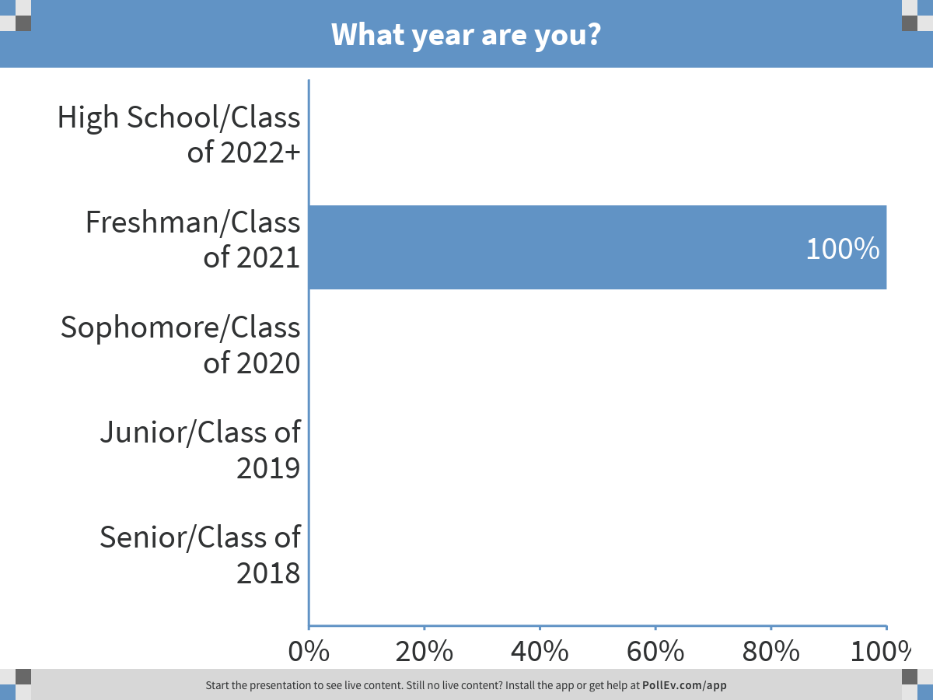
Getting to know your class…
Notes:
What year are you?
https://www.polleverywhere.com/multiple_choice_polls/M19EYibc40g6hMM

Slide 3
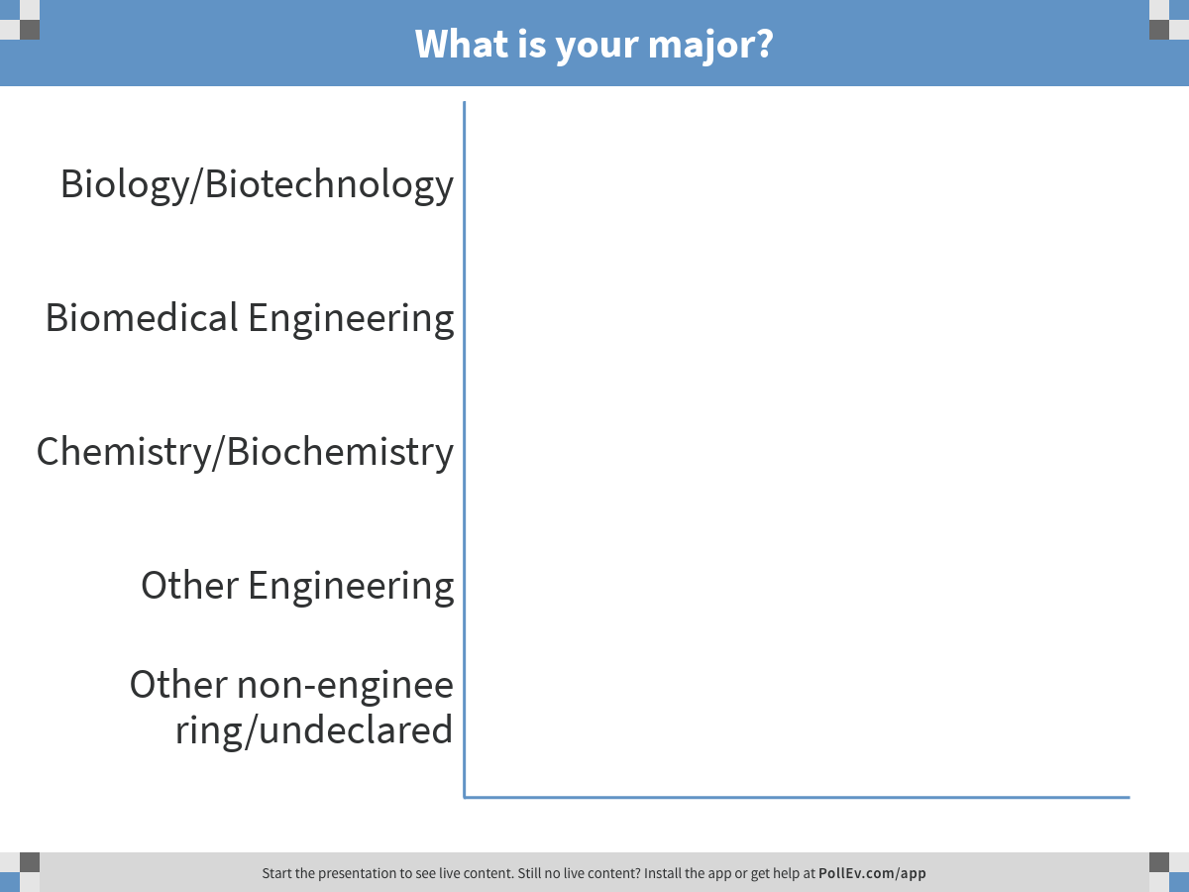
Getting to know your class…
Notes:
What is your major?
https://www.polleverywhere.com/multiple_choice_polls/LDRy6MMGeM4Ea59

Slide 4
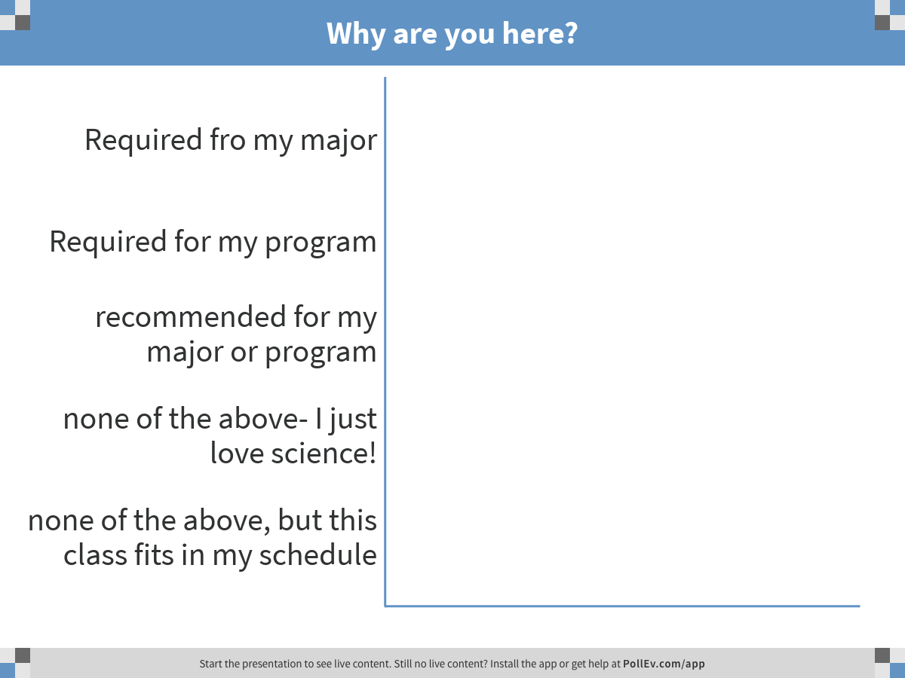
Getting to know your class…
Notes:
Why are you here?
https://www.polleverywhere.com/multiple_choice_polls/fnJE3g7wMc6Wkvm

Slide 5
Course Contact Details
Office hours: by appointment in GP4025
Professor: Dr. Amity Manning (almanning@wpi.edu)
You have my full attention during class and scheduled appointments. I can not guarantee I will be available if you show up unannounced
Prompt responses to after hours emails are not always possible, so please don’t wait until the last minute before a quiz or assignment is due to ask questions!
Your PLAs: Hammad Sadiq(hmsadiq@wpi.edu)
Catherine (Cat) Sherman (casherman@wpi.edu)
study sessions in SL lobby before each quiz:
day/time TBD

Slide 6

Text Book & Reading
This is a fast-paced, interactive class
We will cover 2-3 chapters per week
READ the text BEFORE we cover the material in class so you can:
understand class lectures
participate fully (part of your grade!)
know faster if/when you need to ask for help
Attend 2 formal research seminars
Read and discuss primary research articles
Complete a group project with written and presentation components
Essential Cell Biology 4th Edition
Available in the library and school bookstore
Will read the majority of the text by end of term

Slide 7
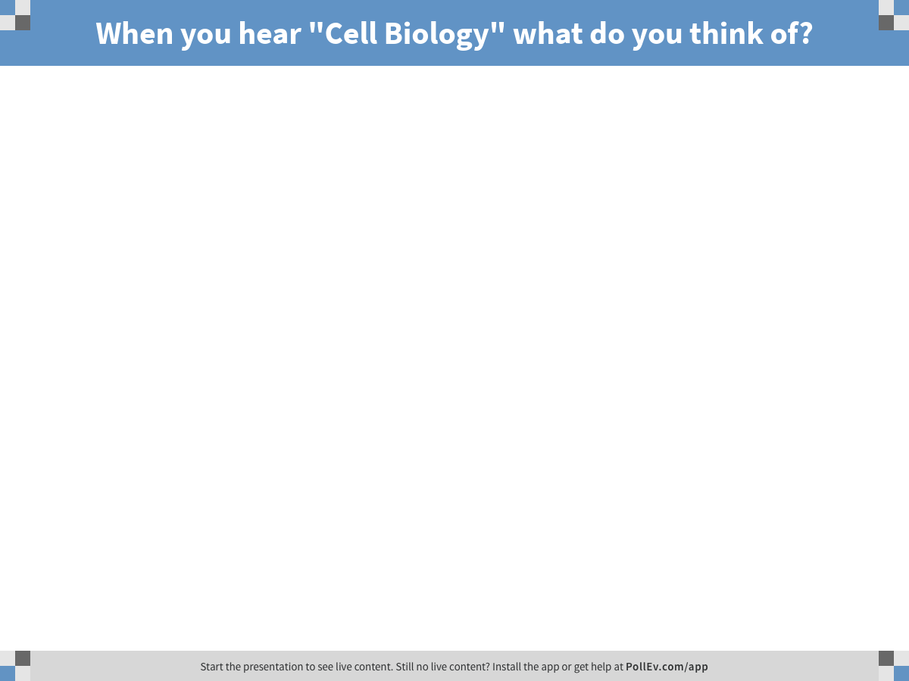
Notes:
When you hear "Cell Biology" what do you think of?
https://www.polleverywhere.com/free_text_polls/GGflBV9eB0xdWX9

Slide 8
By the end of this term you will…
Know a lot about cell Biology
Be comfortable working with primary literature
Know where to find original/primary research articles
Appreciate how primary research articles are different from other sources
Able to read and evaluate a scientific article
Experience how to present research in a way that will inform and engage a non-expert (both as a presenter and an audience member!)
Be willing and able to USE this knowledge and skills in life outside of class

Slide 9
Course Policies and Grading Breakdown
All relevant course materials will be posted on MyWPI website
Grading:
Individual Work: 75%
Weekly quizzes: 48% (4 x 12pts each)
Primary Literature Citations: 8% (8 x 1pt each)
Seminar Attendance and Worksheet: 6% (2 x 3pt each)
Class participation: 13%
Group Work: 25%
Written: 10%
Topic and citation identification and written summary
Presentation: 15%
In class power point presentation integrating and summarizing course material and primary literature

Slide 10
(nearly) Weekly Quizzes (48%)
NO midterm or final
Quizzes will be distributed at 4:00 and collected at 4:50
Extra time CAN NOT be granted for late arrivals
Quizzes are not cumulative BUT new topics build off earlier ones

Slide 11
Course Policies and Grading Breakdown
All relevant course materials will be posted on MyWPI website
Grading:
Individual Work: 75%
Weekly quizzes: 48% (4 x 12pts each)
Primary Literature Citations: 8% (8 x 1pt each)
Seminar Attendance and Worksheet: 6% (2 x 3pt each)
Class participation: 13%
Group Work: 25%
Written: 10%
Topic and citation identification and written summary
Presentation: 15%
In class power point presentation integrating and summarizing course material and primary literature

Slide 12
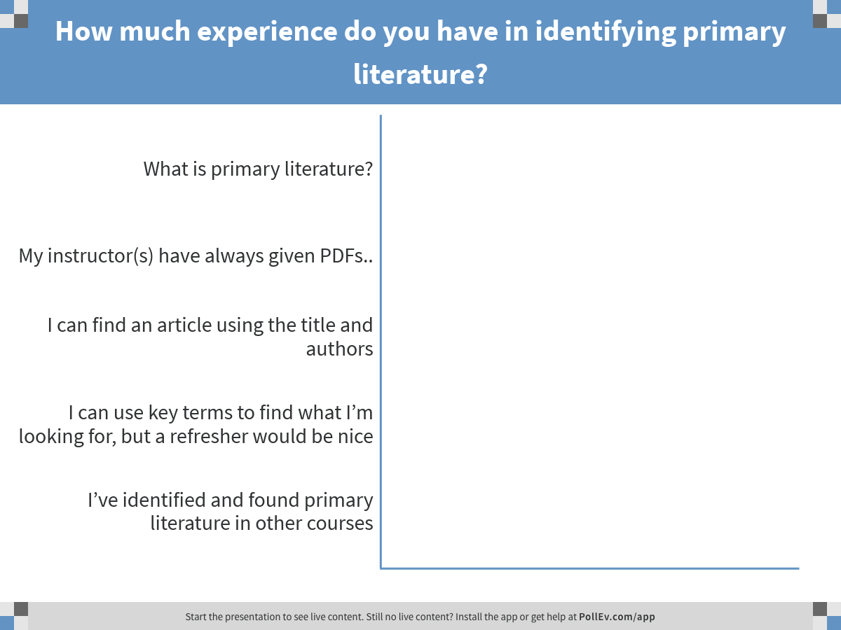
Notes:
How much experience do you have in identifying primary literature?
https://www.polleverywhere.com/multiple_choice_polls/ye2LI7JRYGBaSqm

Slide 13
Primary Literature is…
The original publication of a scientist’s new data, results and theories.
These articles:
Contain a “materials and methods” section
Have undergone peer review prior to publication
Are not written to express an opinion or for financial gain

Slide 14
Primary Literature in this class
Scientific literature related to the course will be assigned
Why read primary scientific literature? Isn’t the important stuff already in the book?
with a text book
with text & Primary Literature
Learn material
Emphasis on what is already discovered/known
A cell Biologist’s view of how a cell works
Outdated?
Retain and integrate material better than in a traditional lecture
Introduce and appreciate open ended questions
Appreciate that research often raises more questions then it answers
Emphasize interdisciplinary nature of cell biology
Learn to integrate data from various sources
See applications of research

Slide 15
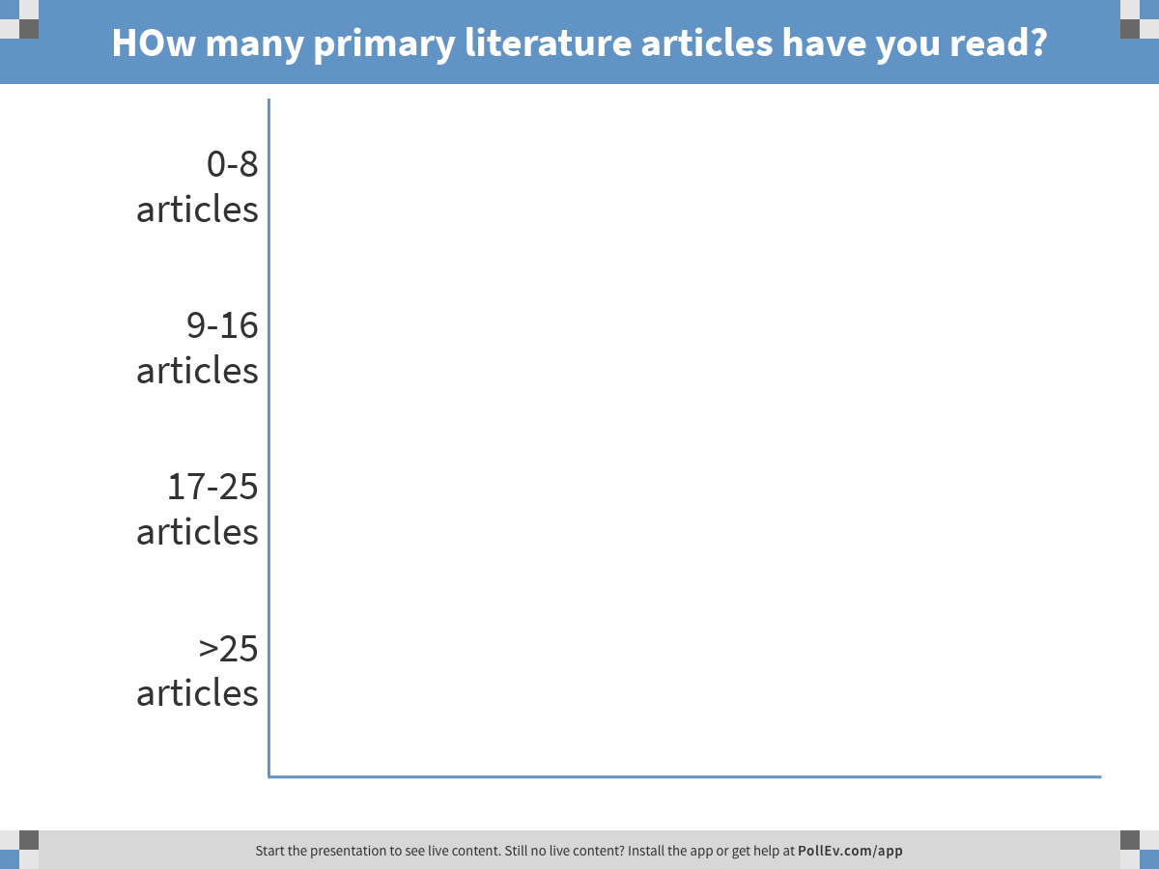
Notes:
HOw many primary literature articles have you read?
https://www.polleverywhere.com/multiple_choice_polls/a9mrdXFimXg48QW

Slide 16
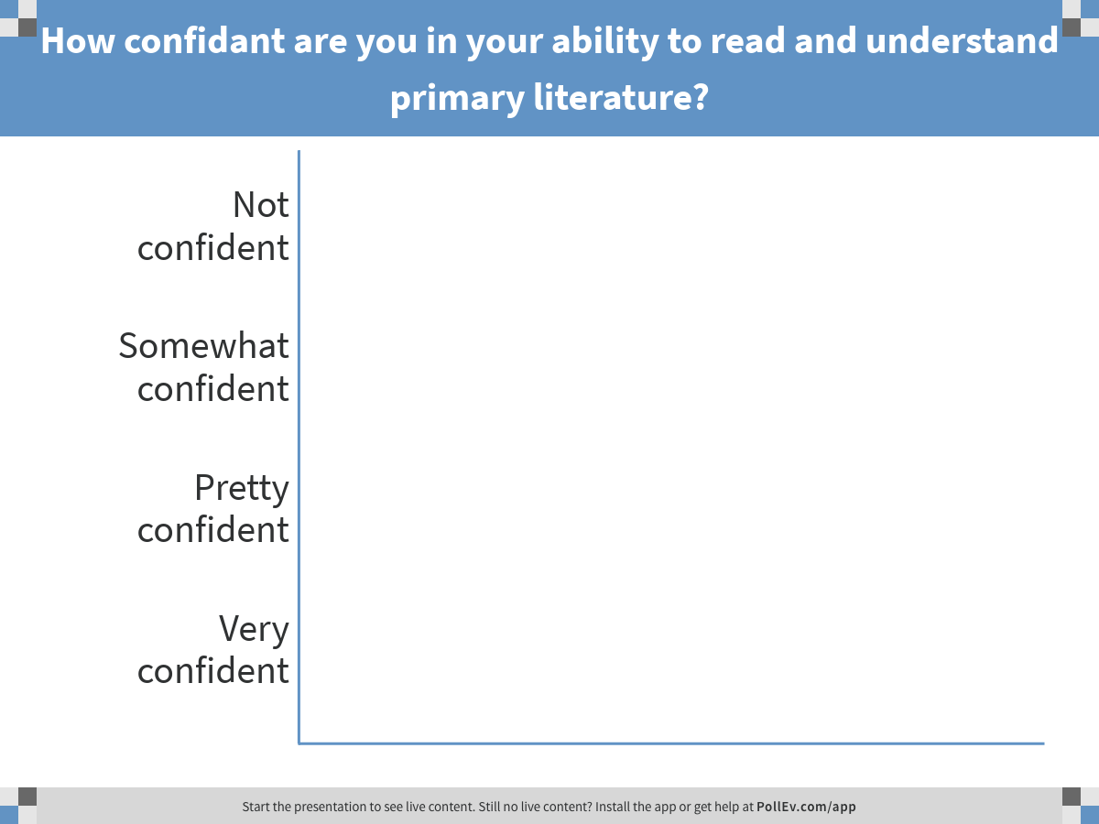
Notes:
How confidant are you in your ability to read and understand primary literature?
https://www.polleverywhere.com/multiple_choice_polls/kLBHCzE5VbjbaGJ

Slide 17
Review and Practice how to find and identify primary research articles
Week #1 Online Homework:
Read tutorial on primary research literature:
What it is
Where to find it
How to use it
How to cite it
Worksheet and first primary literature citation (PLC):
Demonstrate that you can identify a primary research article
Due by midnight on Friday
Term-long assignment: total of 8 PLCs, one submitted each Friday!

Slide 18
Course Policies and Grading Breakdown
All relevant course materials will be posted on MyWPI website
Grading:
Individual Work: 75%
Weekly quizzes: 48% (4 x 12pts each)
Primary Literature Citations: 8% (8 x 1pt each)
Seminar Attendance and Worksheet: 6% (2 x 3pt each)
Class participation: 13%
Group Work: 25%
Written: 10%
Topic and citation identification and written summary
Presentation: 15%
In class power point presentation integrating and summarizing course material and primary literature

Slide 19
Research Seminars (6%)
Invited speakers come to WPI from research institutes around the world to share their most recent published and ongoing unpublished research
Biology Seminar series held throughout the year
Invited speakers who research cell biological questions/problems to present this D term
Attendance and Worksheet
2 seminars: Tuesdays 3/27 and 4/24
Held at 60 Prescott St GP1002, during normal class time (4:15pm- 5pm)
Be prepared (read the article and visit the speaker’s research website)
Complete and submit the worksheet BEFORE the start of seminar (2pts)
Article and worksheet available Friday before seminars
Attend the seminar (1pt)
Sign the attendance sheet

Slide 20
Course Policies and Grading Breakdown
All relevant course materials will be posted on MyWPI website
Grading:
Individual Work: 75%
Weekly quizzes: 48% (4 x 12pts each)
Primary Literature Citations: 8% (8 x 1pt each)
Seminar Attendance and Worksheet: 6% (2 x 3pt each)
Class participation: 13%
Group Work: 25%
Written: 10%
Topic and citation identification and written summary
Presentation: 15%
In class power point presentation integrating and summarizing course material and primary literature

Slide 21
Class Participation (13%)
Participation grade will consider:
self assessments (2x 1pt);
1st and final week of class
peer assessments (1pt)
Confidential comments and feedback for group presentations. Must provide feedback for all group presentations to receive credit
clicker questions and general classroom participation (10pts)
This will be an interactive classroom!
Your participation will benefit you and your classmates

Slide 22
Group Projects
Groups of 4-5 will be formed
sign up on Canvas (under ‘people’: select ‘group’ and add yourself to any open group)
Identify a cell biology concept and related topic of interest that has influenced cell biology or is influenced by cell biology
Get started right away!
We will cover many topics this term, any topic that you can relate back to a concept in any assigned chapter is fair game!
Preview your text book to identify a concept of interest

Slide 23
Group Projects
Assignments
3/23: Selected topics must be uploaded onto canvas site
Cell biology is a BROAD field. Don’t pick a topic someone else is doing.
If there is concern about overlap/excessive similarity between group topics, I may ask one or both groups to change their topic
3/20, 4/2, 4/9 & 4/23: Class time after quizzes will be used to facilitate group discussion and outline building for written and oral presentations
4/7: 2-3 page written summary of your cell biology concept, it’s relation to your chosen topic, and 4 relevant primary literature citations showing how research has advanced our understanding of this topic. Detailed instructions on canvas.
4/24: Each group must upload a power point presentation file on canvas
Group presentations will take place 4/26, 4/27, 4/30 and 5/1
Presentation dates selected by lottery on 4/24
You will provide assessments of your classmates’ presentations as part of your grade

Slide 24
Read chapter 1 for a good introduction & overview of cell biology
Lectures start with chapter 2

Slide 25
Chapter 2 Objectives:
Describe the 4 major TYPES of chemical bonds in cells
Identify the 4 major families of small molecules and the macromolecules they make up
Know HOW condensation reactions form these macromolecules and WHAT the resulting bonds are called
Describe how macromolecules are composed and how they interact.

Slide 26
Chemical Bonds
What does chemistry have to do with cell biology?
Molecular interactions are governed by chemistry!
DNA, RNA, and proteins

Slide 27
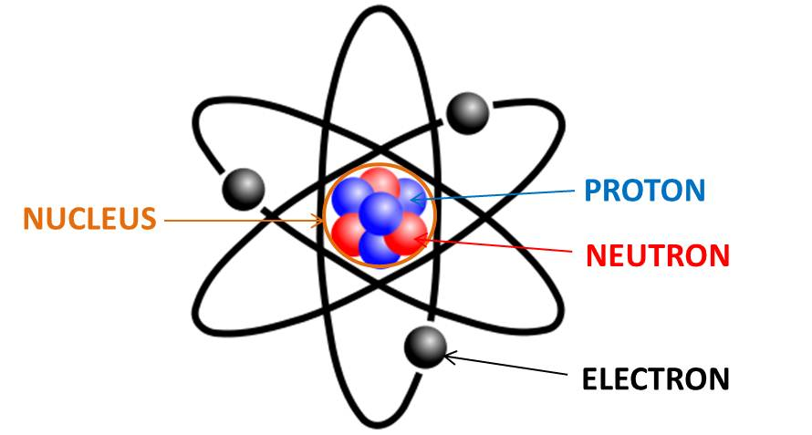
Chemistry of the Cell: living creatures are chemical systems
Cells are made of only a small subset of elements
99% of atoms in the human body are C, H, O and N
Two key features of these chemical reactions to keep in mind:
Tightly regulated reactions of carbon compounds
in an aqueous environment
What dictates the capacity for an element to participate in chemical interactions?
Electrons!

Slide 28
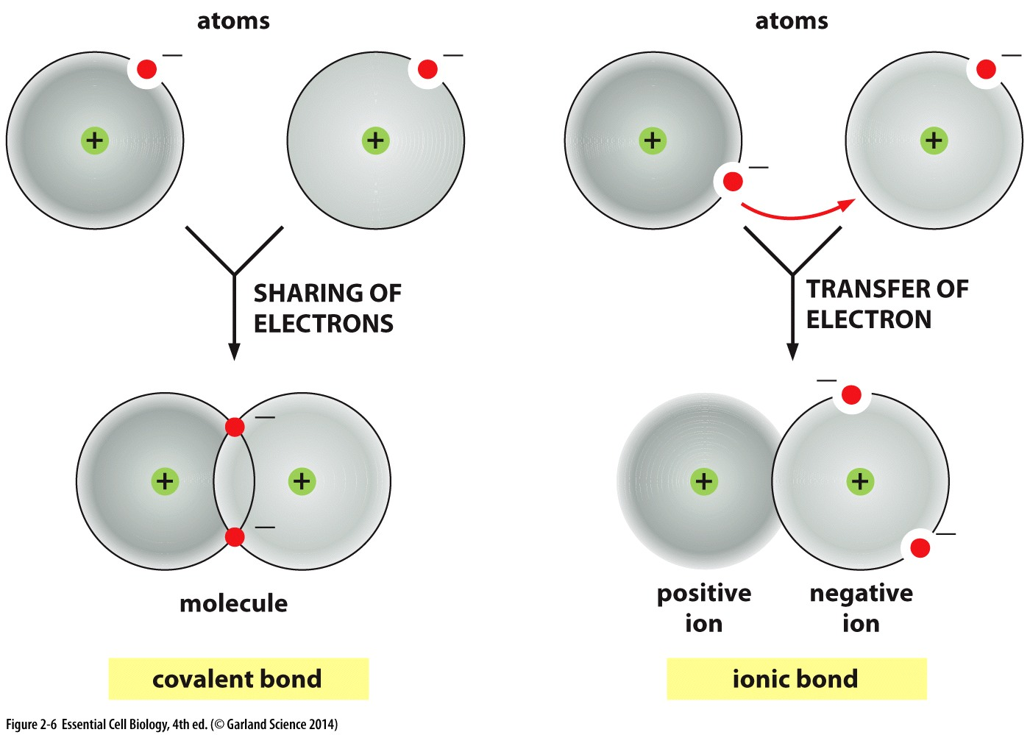
Interacting atoms form molecules
Interactions are determined by the outermost electrons → seek to ‘fill’ outer shell
More electrons shared = shorter, stronger bond
Single bonds: two electrons shared per bond
Double bonds: four electrons shared per bond
Triple bond: six electrons shared per bond

Slide 29

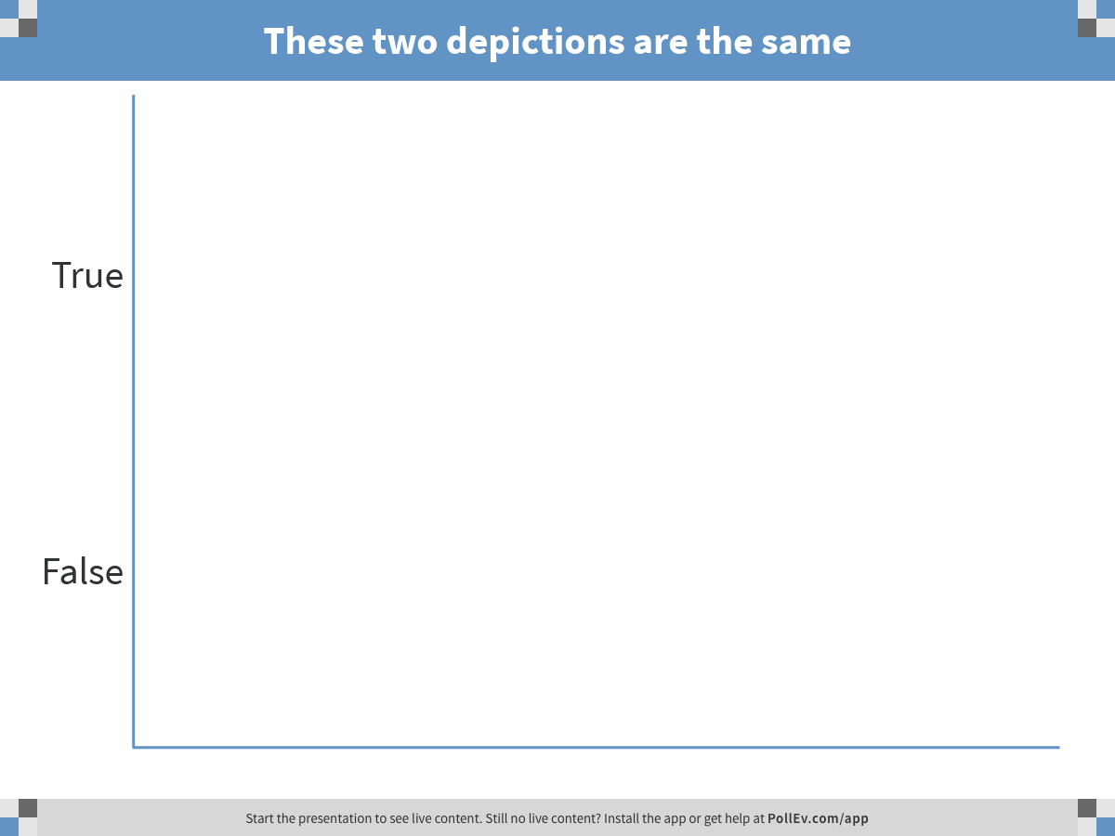
Notes:
These two depictions are the same
https://www.polleverywhere.com/multiple_choice_polls/DnUA2yOlQyEwmKd

Slide 30
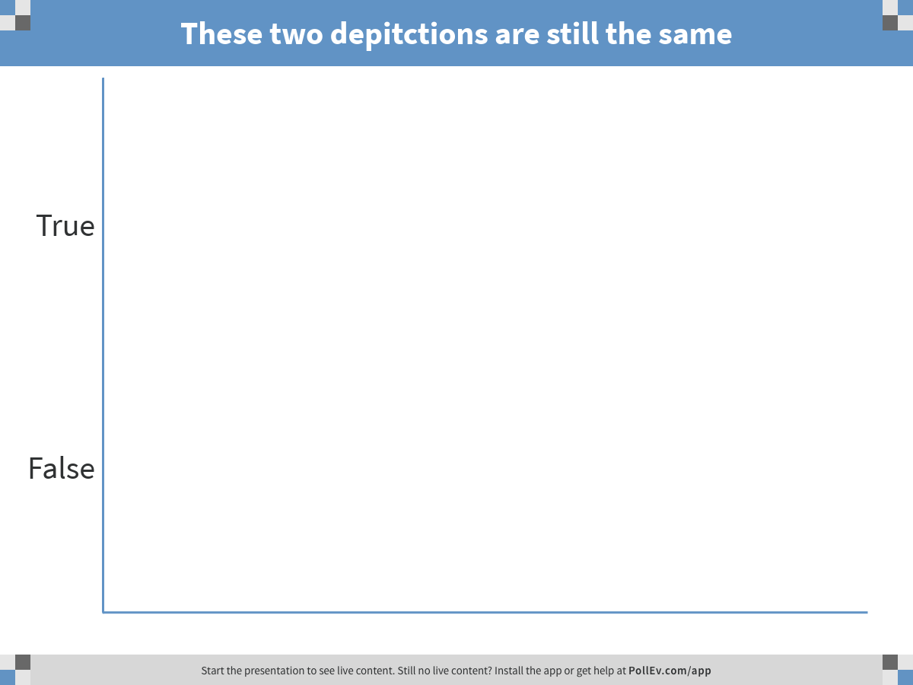
Notes:
These two depitctions are still the same
https://www.polleverywhere.com/multiple_choice_polls/Tmq4XJbiSHtrvO4

Slide 31
Nature of the bonds influence how molecules behave
Single bonds have free rotation- these are the same molecule!
Chloride atoms spend time in all positions in rotation around the C-C bond
Double and triple bonds limit axial rotation- these molecules are geometric isomers
Movement of chloride atoms is restricted
vs
Similar groups apart- less crowding (trans)
* switching between isomers would be energetically costly → strong double bond would need to be broken and reformed after rotation
Similar groups together- more crowding (cis)
vs
Notes:
Cloride = 17 electrons = BIG

Slide 32
Interacting atoms form molecules
Interactions are determined by the outermost electrons → seek to ‘fill’ outer shell
Ionic Bonds:
Individually weak
Ionic bond, ~20x weaker then covalent bond
Collectively strong
Many weak bonds form strong interactions

Slide 33
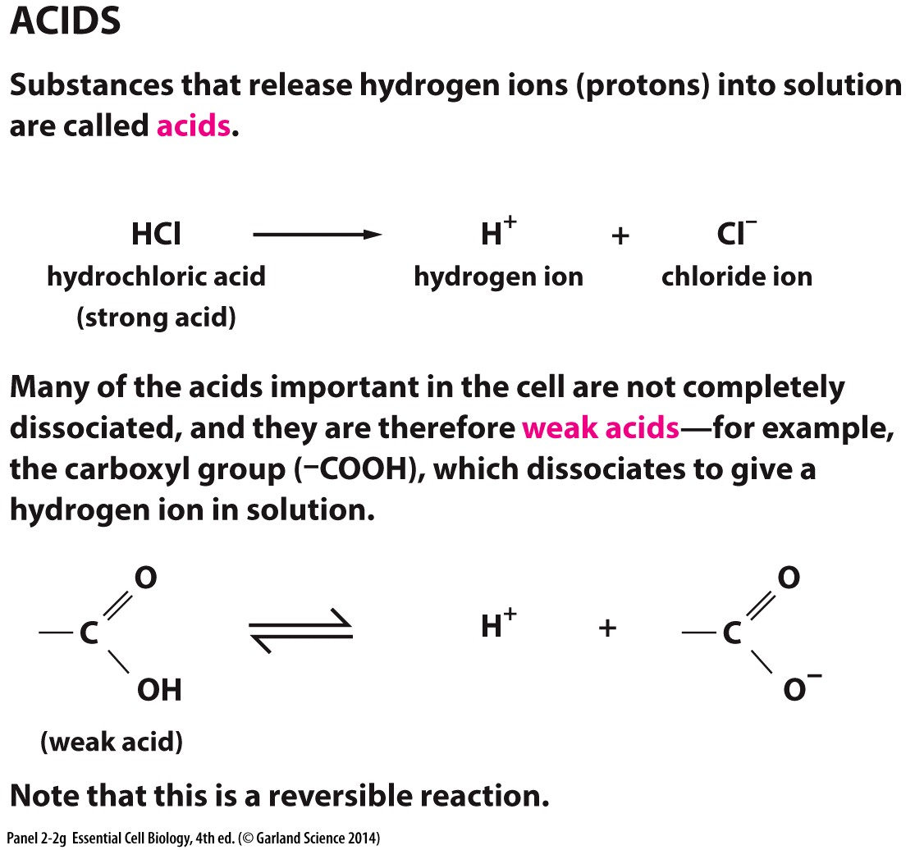
Ionic Bonds
Acids: substances that release ions (protons) into solution
Weak acids: substances where the ion does not completely dissociate
Carboxyl
group
*Important in cellular reactions!
*Readily reversible!

Slide 34
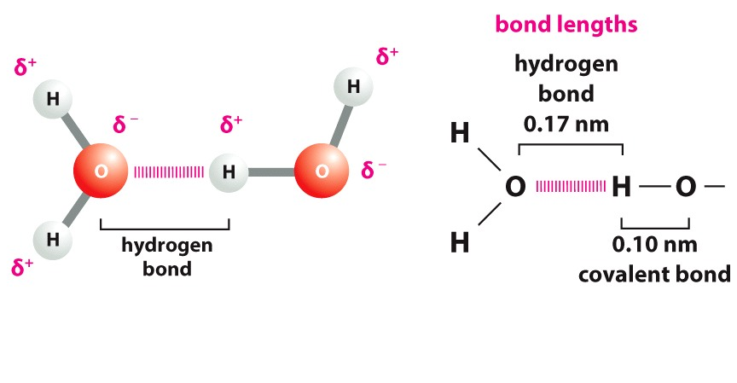
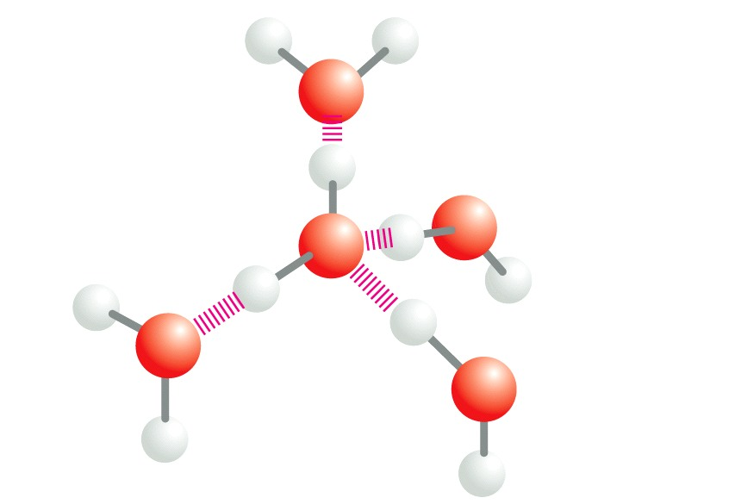
Water can behave like a weak acid …..AND a weak base
Polar molecule
Stoichiometry or spacial organization of the atoms/bonds →
partial positive charge on one side (Hydrogen)
a partial negative charge on the other (oxygen)
Forms Non covalent interactions known as Hydrogen Bonds
Hydrogen
bonded lattice
Unusual properties:
High surface tension
High heat of vaporization

Slide 35
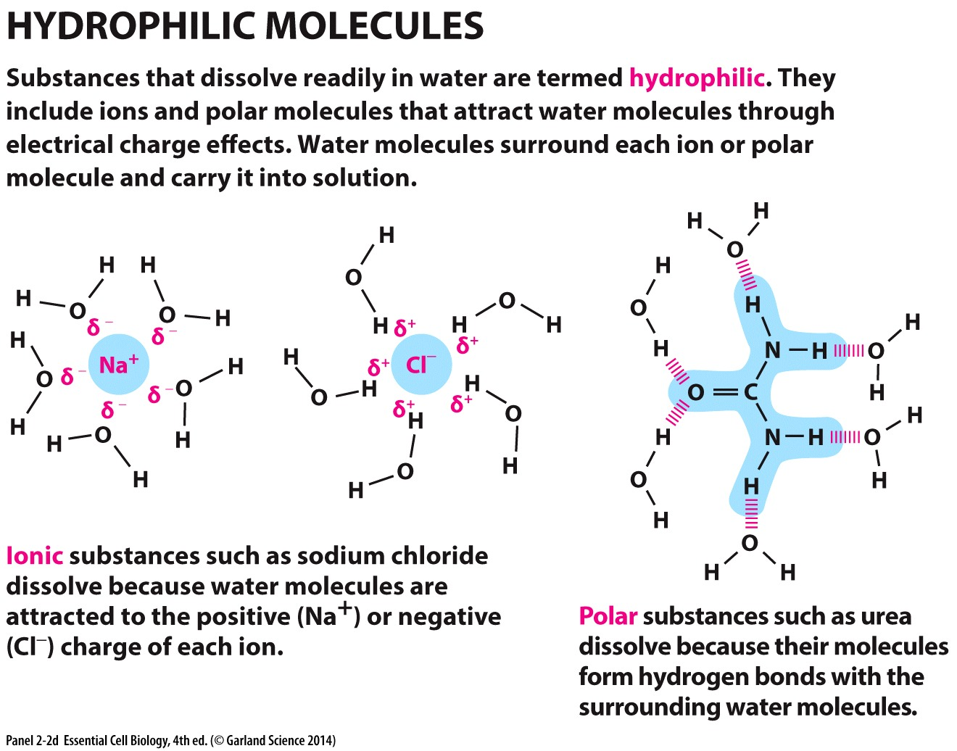
Hydrophilic Molecules
Include ions and polar molecules
Dissolve readily in water
Exploit water’s polar nature
Form hydrogen bonds
Hydrogen bonds with Oxygen and Nitrogen
both + and – charged ions

Slide 36
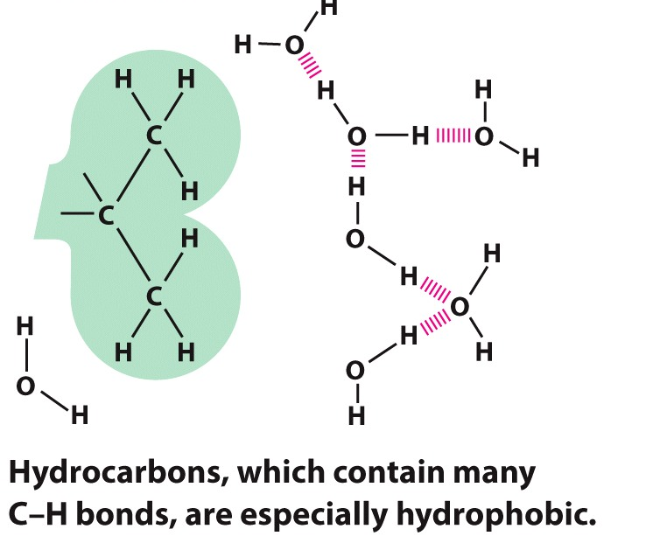
Hydrophobic Molecules
Include non polar bonds (like covalent bonds)
Do not dissolve in water
Notes:
Lack charged or partially charged residues that allow for interactions with water molecules

Slide 37
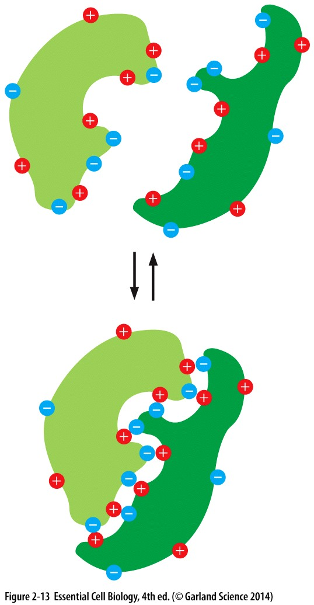
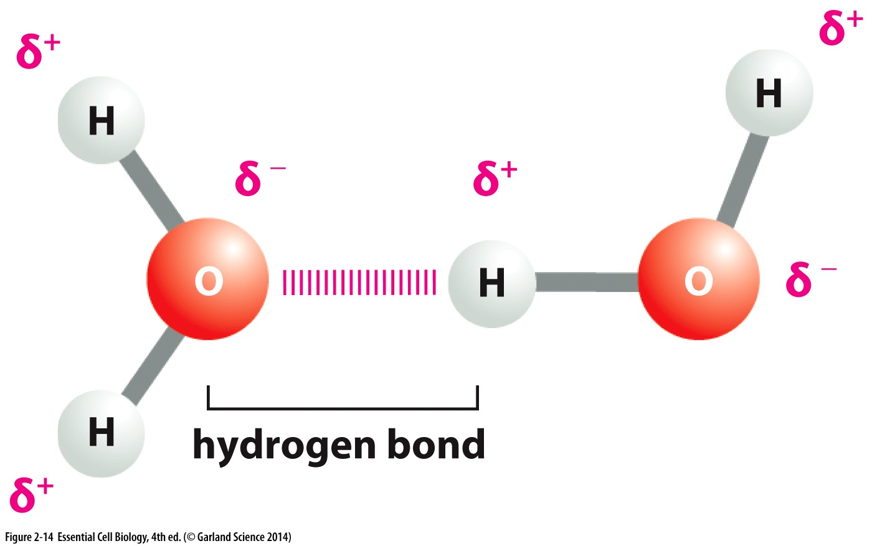
What are they used for?
Molecules are formed with covalent bonds
Non covalent bonds help bring molecules together in cells
Aqueous cellular environment → Hydrogen bonds are important non-covalent bonds for many biological molecules

